Slide 1
Expand your skills with Xamarin from native to cross-platform

Slide 2

Oriol Noya Giner
Senior Mobile Developer
@oriolnoya
onoya@devsdna.com
Marcos Cobeña Morian
Senior Mobile Developer
@marcoscobena_
marcos@devsdna.com

Slide 3

Introduction to Xamarin
Xamarin for
iOS developers
From iOS
to Xamarin.iOS
From Xamarin.iOS
to Xamarin.Android
From Xamarin.Classic
to Xamarin.Forms

Slide 4
Introduction to Xamarin

Slide 5





Xamarin – A Complete Mobile Solution
Develop
Test
Build
Distribute
Monitor
Notes:
Xamarin is not only development tool, but a complete solution to create ui tests, builds in the cloud, distribute and monitor your apps.
Xamarin allow teams to share knowledge and skills between platforms, unifying the testing, building, distribution and monitoring environments.
At the end, Xamarin is about empowering skills, reusing them across platforms and create more effective environments for producing digital goods.

Slide 6
Traditional software development approach
iOS
Android
Windows
Objective-C
Swift
Xcode
Java
Android Studio
C#
Visual Studio
No shared code • Many languages & development environments • Multiple teams

Slide 7
The worst of each platform approach
Lua
Javascript
Actionscript
HTML+CSS
App Generator
Limited native API access • Slow performance • Poor user experience

Slide 8
Xamarin approach: Native UIs, shared code
Storyboards, Xibs UI
AXML UI
XAML UI
Shared code
Business Logic
Data Access
Network Communication
Shared C# codebase • 100% native API access • High performance

Slide 9
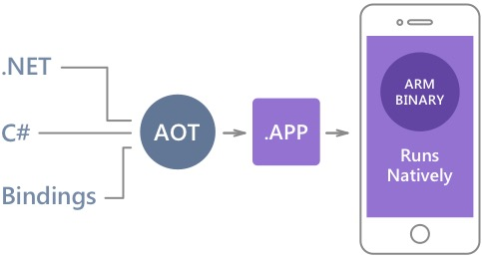
Native performance
Xamarin.iOS does full Ahead Of Time (AOT) compilation to produce an ARM binary for Apple’s App Store.
Xamarin.Android takes advantage of Just In Time (JIT) compilation on the Android device.

Slide 10
100% iOS API Coverage
MapKit
UIKit
iBeacon
CoreGraphics
CoreMotion
System.Net
System
System.IO
System.Linq
System.Xml
System.Data
System.Windows
System.Numerics
System.Core
System.ServiceModel

Slide 11
✓Always Up-to-Date
Same-day support:
iOS 5
iOS 6
iOS 7
iOS 7.1
iOS 8
iOS 9
iOS 10
Full support for:
Apple Watch
Android Wear
Amazon Fire TV
Google Glass
and much more

Slide 12
Xamarin for iOS Developers

Slide 13
Xamarin value for an iOS developer
Use of your current skills: Interface Builder, same APIs, develop from Mac or Windows, publish using XCode…
Swift
Objective-C
Xamarin
let locationManager = CLLocationManager()
locationManager = [[CLLocationManager alloc] init];
var locationManager = new CLLocationManager();
self.locationManager.requestWhenInUseAuthorization()
[self.locationManager requestWhenInUseAuthorization];
locationManager.RequestWhenInUseAuthorization();
locationManager.delegate = self
locationManager.desiredAccuracy = 10
locationManager.startUpdatingLocation()
locationManager.delegate = self;
locationManager.desiredAccuracy = 10;
[locationManager startUpdatingLocation];
locationManager.LocationsUpdated += LocationsUpdated;
locationManager.DesiredAccuracy = 10;
locationManager.StartUpdatingLocation();
Same number of lines, same name of members and objects…
In a Xamarin iOS project you will have info.plist, AppDelegate.cs, you can use Image Assets… all the same you have in swift and Objective-C

Slide 14
Xamarin value for an iOS developer
One technology stack for all platforms, easying the migration of apps from iOS to Android, Windows, Tizen, Mac…
Unit Testing
REST Service access
Local SQLite
Navigation
Data validation
File I/O
Shared logic controller
UI
Hardware APIs
Store APIs
UI
Hardware APIs
Store APIs
UI
Hardware APIs
Store APIs
UI
Hardware APIs
Store APIs
UI
Hardware APIs
Store APIs

Slide 15
Xamarin value for an iOS developer
Simplified maintenance, logic, network, data access is shared across platforms so is easy to identify and fix bugs, add features…
Pure Native development bugs
Xamarin Native development bugs
Objective-C / Swift
Java
C#
REST Service
access
logic code
REST Service
access
logic code
REST Service
access
logic code
Different implementations can have different bugs
Requires different teams to fix them
Different timings and complex QA to get same behavior
Same implementations, same bugs
Easy to fix on all platforms
Same timings and simplified QA for same behavior.

Slide 16
Xamarin value for an iOS developer
Open Source stack, all Xamarin SDK, runtime, CLI and libraries are under MIT license
granted, free of charge, to any person obtaining a copy of this software and associated documentation files (the "Software").
deal in the Software without restriction, including without limitation the rights to use, copy, modify, merge, publish, distribute, sublicense, and/or sell copies of the Software.
https://github.com/xamarin

Slide 17
Does all these mean Xamarin is a perfect unicorn in mobile software development?

Slide 18
Short answer: NO!

Slide 19
Xamarin value for an iOS developer
Xamarin is a development time abstraction, is another layer of software to deal with. As any other piece of software, has its own bugs and release cycles.
When using Xamarin for cross platform, you can reuse your skills from iOS, but you need to have some knowledge of Android or Windows to create full native apps with Xamarin on these platforms.
Is not free, talking about time spending, to have a working environment for iOS, Android & Windows development with Xamarin.
Each platform has its own release times, updates and you need to have all iOS, Android & Windows native SDKs up-to-date to work with Xamarin on all of them. (Because of the native nature of Xamarin)

Slide 20
Xamarin value for an iOS developer
Xamarin is not the ultimate unicorn out of a rainbow, is just an honest, truly native and respectful way to develop awesome apps. Xamarin doesn’t allow you to do anything you can’t do on the native toolset.
XAMARIN ONLY TRIES TO HELP CROSS PLATFORM DEVELOPMENT, SO DEVS CAN REUSE THEIR SKILLS WHILE FOCUSING ON THE REALLY IMPORTANT: CRAFT AWESOME APPS

Slide 21
From iOS to Xamarin.iOS

Slide 22
C# for our code
C# is a simple, modern, object-oriented, and type-safe programming language.
Very similar to C, C++
Highly expressive sintax
Current version 7.0
Is not a newie in the block, it first version is dated back from 2000, 17 years ago.
Is an ISO (ISO/IEC-23270) and ECMA (ECMA-334) approved standard.
In the beginning it was called COOL (C Object Oriented Language) but the name was changed to C# for trademarks
Xamarin support the last version of the language, 7.0
C# born as an OOP language but with every new version is acquiring features from the functional programming paradigm.
In fact, if you take a look at SWIFT and C# code, is almost equal:
If you develop with SWIFT, swapping to C# is easy job.
let locationManager = CLLocationManager()
var locationManager = new CLLocationManager();
self.locationManager.requestWhenInUseAuthorization()
this.locationManager.requestWhenInUseAuthorization();
locationManager.delegate = self
locationManager.desiredAccuracy = 10
locationManager.startUpdatingLocation()
locationManager.LocationsUpdated += LocationsUpdated;
locationManager.DesiredAccuracy = 10;
locationManager.StartUpdatingLocation();

Slide 23
C# for our code
From it conception, C# is focused on fast development, including tools in the language to allow devs to easy do tasks:
Generics
Allow us to work with strongly typed objects in dev time.
Gave us compilation time type constraint and validation.
public class MyList
{
public IList<Object> Items { get; set; }
public void Add(Object newElement)
{
Items.Add(newElement);
}
public Object GetFirst()
{
return Items.First();
}
}
public class MyList<T>
{
public IList<T> Items { get; set; }
public void Add(T newElement)
{
Items.Add(newElement);
}
public T GetFirst()
{
return Items.First();
}
}
var list = new MyList();
list.Add("1");
list.Add(23);
int firstNotTyped = (int)list.GetFirst();
var typedList = new MyList<int>();
typedList.Add(1);
typedList.Add(23);
int firstTyped = typedList.GetFirst();
Non generic requires boxing/unboxing
Generic allow us for type safe development

Slide 24
C# for our code
From it conception, C# is focused on fast development, including tools in the language to allow devs to easy do tasks:
Lamba expressions
Allow us to write a piece of code (method or function) selftcontained inside another piece of code scope
We can store that code in a variable (delegated way) or write it inline to use it.
We can execute a lambda expression variable every time we need it.
The execution context will be the original scope where we defined the expression, not the one from where we are executing it at any time.
This allow us to abstract execution from definition, create execution patterns and decouple our code.
Action lambdaOne = () =>
{
Console.WriteLine(”Text from an action without returning value");
};
Func<bool> lambdaTwo = () =>
{
Console.WriteLine("Text from a Func returning a bool value");
return true;
};

Slide 25
C# for our code
From it conception, C# is focused on fast development, including tools in the language to allow devs to easy do tasks:
LiNQ:
Is an in line query language to query memory objects, in a SQL like way, but with strong typed code.
Used for query data, lists or complex objects, to sort, order, group…
It can be used in a fluent language or query language way:
The first statement above is the query language, the second is the fluent one. Both statements return the same data.
In this sample we are seeing OrderBy and Select operators but there are much more: Where, OrderByDescending, Any, GroupBy, Sum, Max, Min, SelectMany…
It also can be extended easily with extension methods.
Student YoungerStudent = (from stu in students
orderby stu.Age
select stu).FirstOrDefault();
Student YoungerStudent = students.OrderBy(stu => stu.Age).FirstOrDefault();

Slide 26
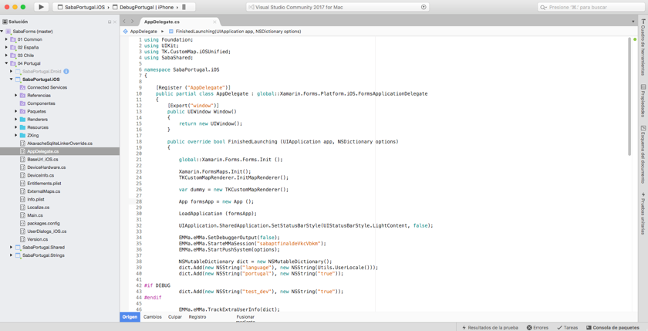
Xamarin development environment
You don’t need Windows or a PC to use Xamarin, you can use it right directly from your Mac and integrates with your iOS development environment.
To create projects and write logic code you can use Visual Studio 4 Mac

Slide 27
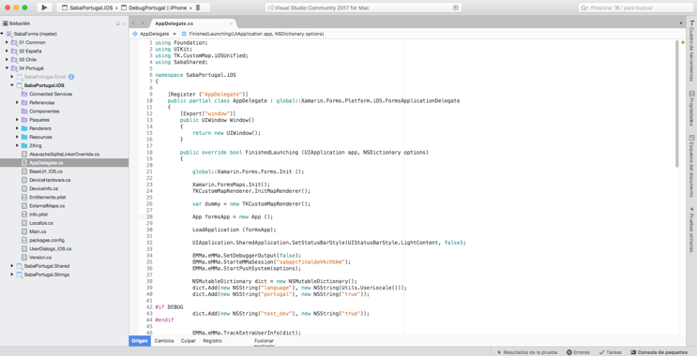
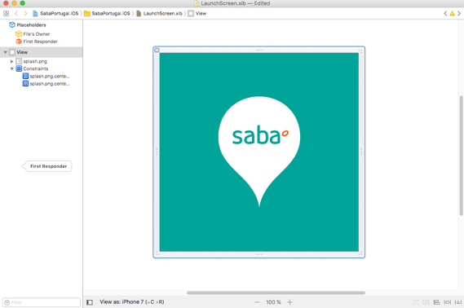
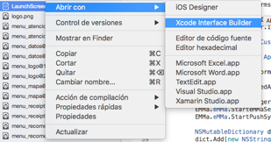
Xamarin development environment
From Visual Studio 4 Mac you can edit Storyboards directly or launch Apple Interface Builder to edit them.

Slide 28
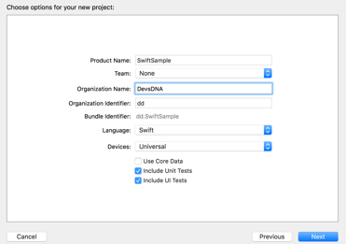
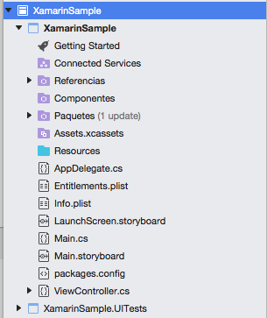
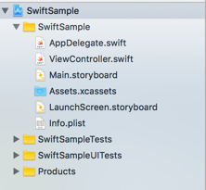
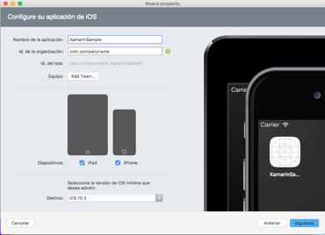
New projects
New blank project from swift or xamarin iOS have a similar file structure…

Slide 29
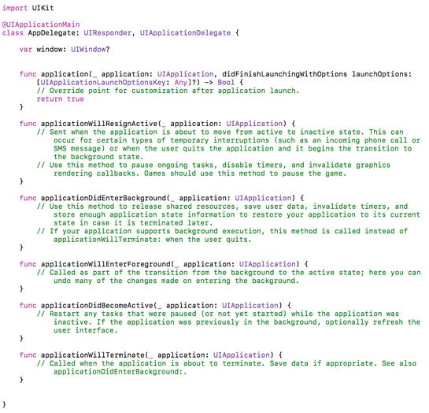
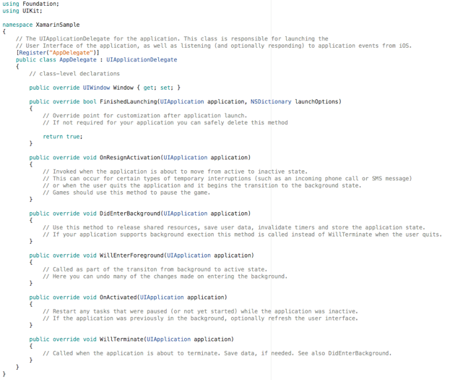
New projects
… even at code level on AppDelegate.swift vs AppDelegate.cs

Slide 30
Reusing your native skills
You don’t need to redo all your native work, just reuse it in Xamarin using native binding projects.
Due to how Xamarin works, you can easily use native libraries and SDKs in Xamarin.
During development time you need a C# interface to your native methods.
That interface is removed in compilation, when native code is created.
Xamarin has a tool called objective sharpie, that create the wrapper class in C#.
You can work with libraries in three flavours:
As a precompiled static library with .a and .h files
As a precompiled framework.
As source code files with .m and .h files
You will need the Xcode command line tools
Simply add the .a file to the Xamarin Binding project and execute objective sharpie over the .h files of your static library.
Then you can start using your native library automatically in Xamarin iOS as any other Xamarin library

Slide 31

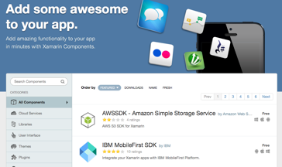

Get help from a growing ecosystem
Xamarin allows you to reuse your current native skills, but also expand them to a new ecosystem.
Nuget, the .NET ecosystem package management, has more than 89.000 packages, lot of them being compatible with Xamarin.
Xamarin components has more than 500 components ready to use in your apps, both free and pay. From QR scanning, to UI components, facebook auth, Firebase, Stripe… lot of them ar ready to use native bindings for both iOS and Android.
As Xamarin is open source, lot of libraries were going open source lately like Akavache, MVVMCross, ReactiveUI… if you search GitHub for Xamarin, will find more than 16.000 repositories out there…

Slide 32

DEMO TIME!
Talk is cheap, lets see some real code...
Made with by

Slide 33
From Xamarin.iOS to Xamarin.Android

Slide 34
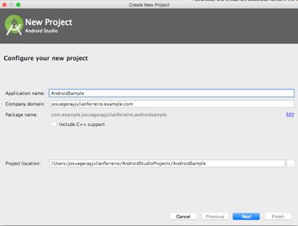
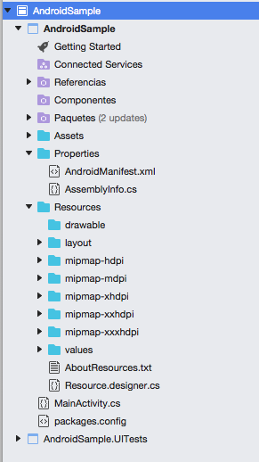
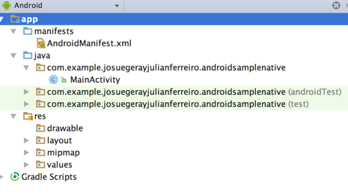
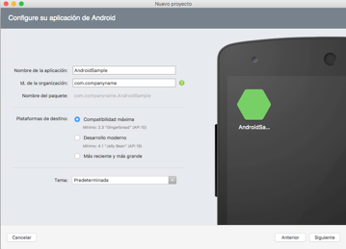
From iOS to Android, using Xamarin
The same way iOS native projects are similar to Xamarin.iOS, Android java projects are the same in Xamarin.Android.

Slide 35
From iOS to Android, sharing is caring
One of the best things about Xamarin is enabling you to easily port to new platforms…
While at the same time, maintain every platform singularity and special points, not simply doing a cross port of all the app including the UI.
With native iOS or Xamarin iOS, you have your logic in ViewControllers, and your UI on XIBs/Storyboards (or even on code).
One of the first things we need to do to be able to port our app to work in Android also is to find a sharing way for our logic.
We can make this unifying the presentation pattern to use, going from MVC to MVVM, a commonly used presentation pattern in Xamarin

Slide 36
From iOS to Android, sharing is caring
MVVM allow us to let only UI code to be in the platform projects, while moving all logic, shared resource… to a Core project
Core project
View’s logic (VIEWMODELS)
Shared code
Language localization resources…
MVVM
databindings
MVVM
databindings
Storyboards/Xibs + ViewControllers
(VIEWS)
Image assets
Platform specific code
Activities/Fragments (VIEWS)
Resources
Platform specific code
Xamarin.iOS Project
Xamarin.Android Project

Slide 37
From iOS to Android, sharing is caring
There are several frameworks that allow us to implement MVVM with iOS and Android, sharing the most of the code
MVVMCross is one of the most famous framework and used almost as the “de facto” standard for developing Xamarin apps.
MVVMCross allow us to make “links” between UI (Activity, Storyboard) and logic (ViewModels), also unify navigation and presentation.
ReactiveUI is a new framework based on RX, Reactive Extensions and Reactive programming, a more functional way of doing things.
There is lot more in the community, like MVVMLight, Prism, Bind…

Slide 38
DEMO TIME!
Lets take a look at this droid thing…
Made with by

Slide 39
From Xamarin.Classic to Xamarin.Forms

Slide 40
Xamarin Forms, higher code sharing
Storyboards, Xibs UI
AXML UI
XAML UI
SHARED UI CODE WITH XAML or C#
Shared code
Business Logic
Data Access
Network Communication
Shared code
Business Logic
Data Access
Network Communication
Xamarin Native
Xamarin Native + Xamarin Forms

Slide 41
Xamarin Forms, higher code sharing
Xamarin Forms is a UI definition technology, built upon Xamarin Native, to ease the cross platform development.
Xamarin Forms allow developers to define the app UI using XAML (Xamarin App Markup Language) or C#.
During compilation, XAML is compiled into C# code.
At runtime, UI definition is parsed by Xamarin.Forms UI engine and native controls are used to draw the UI.
Every Xamarin Forms control have a default Render in every platform, this renderers can be overwritten by developers to modify how a control is drow in an app, using Custom Renders.
Also Xamarin Forms implements shared navigation, shared animation subsystem, dependency services and MVVM bindings so is easy to start an app from scratch.
SHARED UI CODE WITH XAML or C#
Shared code
Business Logic
Data Access
Network Communication
Xamarin Native + Xamarin Forms

Slide 42
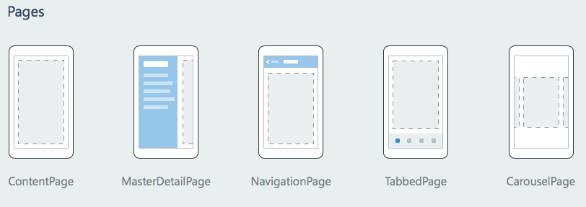
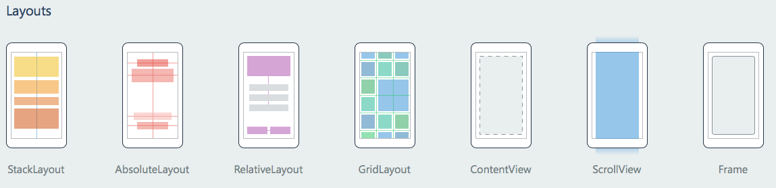
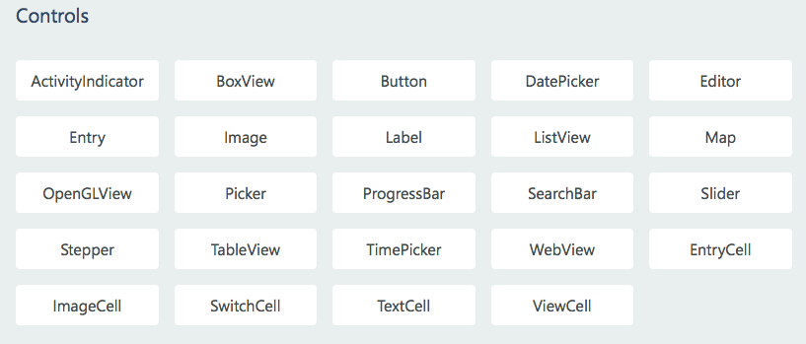
Xamarin Forms, higher code sharing
Xamarin Forms include elements presents in all platforms:

Slide 43
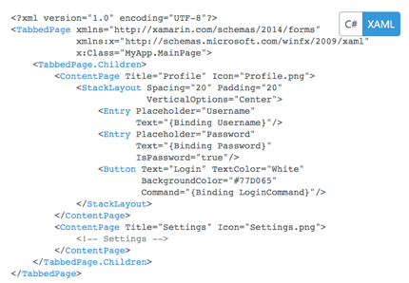
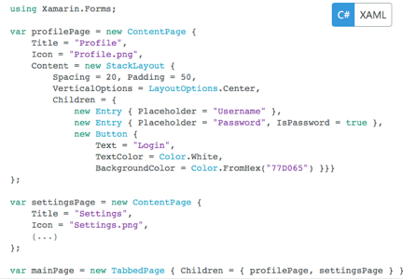
Xamarin Forms, higher code sharing

Slide 44
Xamarin Forms, when to use it?
In Xamarin.Forms 3.0, you will be able to use forms views inside Native apps, mixing both approach, but for now…
If code sharing is more important than UI customization
Doesn’t mean you can’t customize Xamarin Forms, but lot of customizations would make it better to go Native.
When having tight time constraints, having both platforms working is more important than going pixel perfect.
Even when with last version of Forms, going pixel perfect is feasible, is more hard than with Native tools.
Also is very interesting to note: you can make a Xamarin.iOS native project and use Forms for Windows, Android, Tizen UI, while sharing your logic with the iOS native project.

Slide 45
DEMO TIME!
So…. Sharing UI? Mmmm let me see that monster…

Slide 46




Whakoom
Comic collection management app for iOS and Android wrote in Xamarin.Forms

Slide 47


Beezy Pocket
Messenger app for intranets for iOS wrote in Xamarin native.

Slide 48
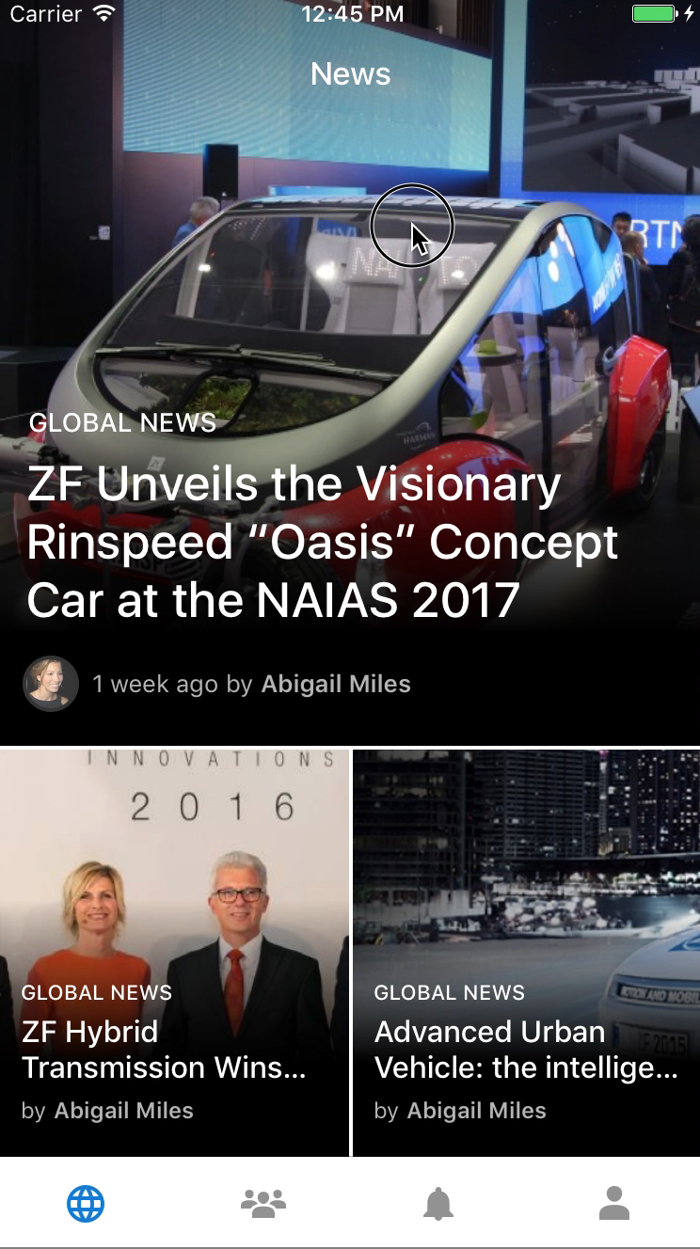

Beezy Mobile
Intranet app for iOS and Android wrote in Xamarin native.

Slide 49

SmartTracker
Personal & Vehicle tracking app for iOS and Android wrote in Xamarin Forms.

Slide 50
Made with
by
Q&A
Expand your skills with Xamarin from native to cross-platform

